Slide 1
DULUX PAINTS- Pakistan
Where Your Imagination Meets Infinite Possibilities!
Start
Notes:
Transcript:
Welcome to the Vibrant World of Colours with Dulux Paints Pakistan – Where Your Imagination Meets Infinite Possibilities!

Slide 2

Diverse Paint Solutions
Interior Wall Paints
Exterior Wall Paints
Trims
Woodcare
Waterproofing
Pre Deco
Click on each category to begin your exploration.
Notes:
Transcript:
We offer a spectrum of paint solutions, each catering to specific needs and aesthetics.
Click on each category to begin your exploration.
Developer Notes:
Show six clickable tabs
Image links:
https://www.freepik.com/free-photo/road-city_1278133.htm#query=house%20image&position=21&from_view=search&track=ais&uuid=fdfd70d5-e05f-449c-82d3-c411ddb107e0

Slide 3
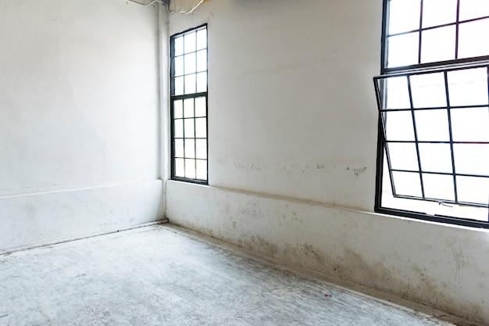

Introduction
Oh no! What happened to my walls?
Notes:
Transcript:
Meet Farah, a free-spirited woman who most often finds herself discontent with the present aesthetics of her home’s walls.
Developer Notes:
Show farah looking at her home sad, show the cracks and the stains of the room in a 360 degree.
Image links:
https://www.freepik.com/premium-vector/arabian-casual-woman-character-set_2609364.htm#query=lady%20charecter%20muslim&position=29&from_view=search&track=ais&uuid=c0631cd7-6e82-4e33-94c4-1a1687df892e

Slide 4
Introduction
I can't even invite someone.
Notes:
Transcript:
She feels embarrassed to invite guests to her home.
Developer Notes:
Show farah looking at her home sad, show the cracks and the stains of the room in a 360 degree.
Image links:
https://www.freepik.com/premium-vector/arabian-casual-woman-character-set_2609364.htm#query=lady%20charecter%20muslim&position=29&from_view=search&track=ais&uuid=c0631cd7-6e82-4e33-94c4-1a1687df892e

Slide 5
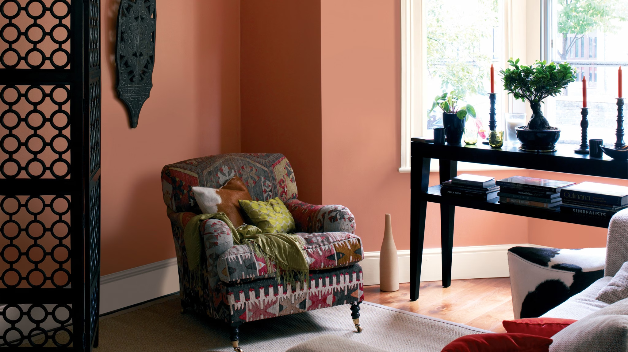
Introduction
Click on Farah’s image to know more.
Notes:
Transcript:
Farah seeks not only a visual appeal but also comfort and pride in her space.
Click on Farah’s image to know more.
Developer Notes:
Image links:
https://www.freepik.com/premium-vector/arabian-casual-woman-character-set_2609364.htm#query=lady%20charecter%20muslim&position=29&from_view=search&track=ais&uuid=c0631cd7-6e82-4e33-94c4-1a1687df892e
https://www.dulux.in/en/colour-inspiration/channel-global-chic-warm-earthy-shades

Slide 6
Introduction
My house is plagued by a multitude of interior wall problems. The once-charming walls now appear dull and worn out. What should I do?
Notes:
Transcript:
My house is plagued by a multitude of interior wall problems. The once-charming walls now appear dull and worn out. What should I do?
Developer Notes
Show Farah is thinking.
Image links:
https://www.freepik.com/free-photo/clean-windows-empty-white-house-blank_3012151.htm
https://www.freepik.com/premium-vector/arabian-casual-woman-character-set_2609364.htm#query=lady%20charecter%20muslim&position=29&from_view=search&track=ais&uuid=c0631cd7-6e82-4e33-94c4-1a1687df892e

Slide 7

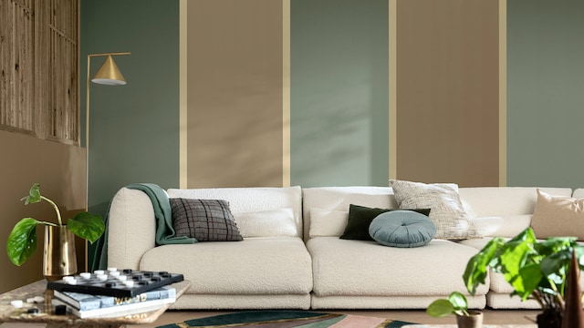
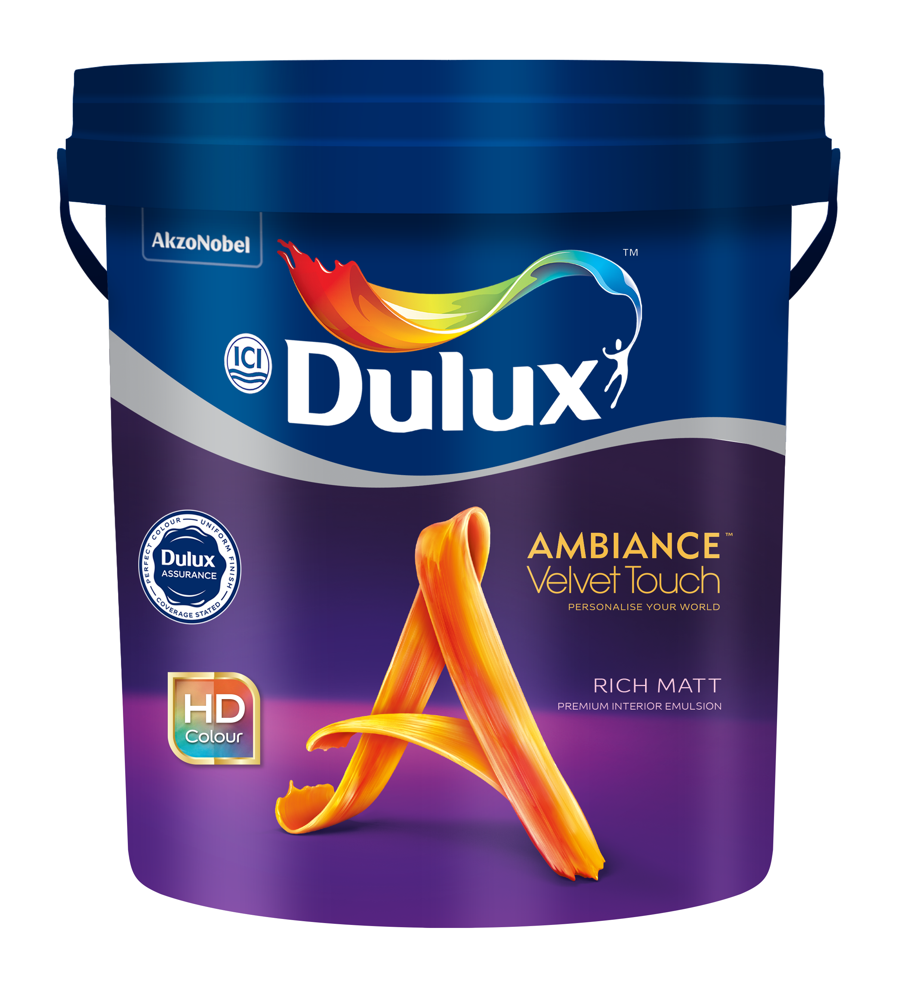
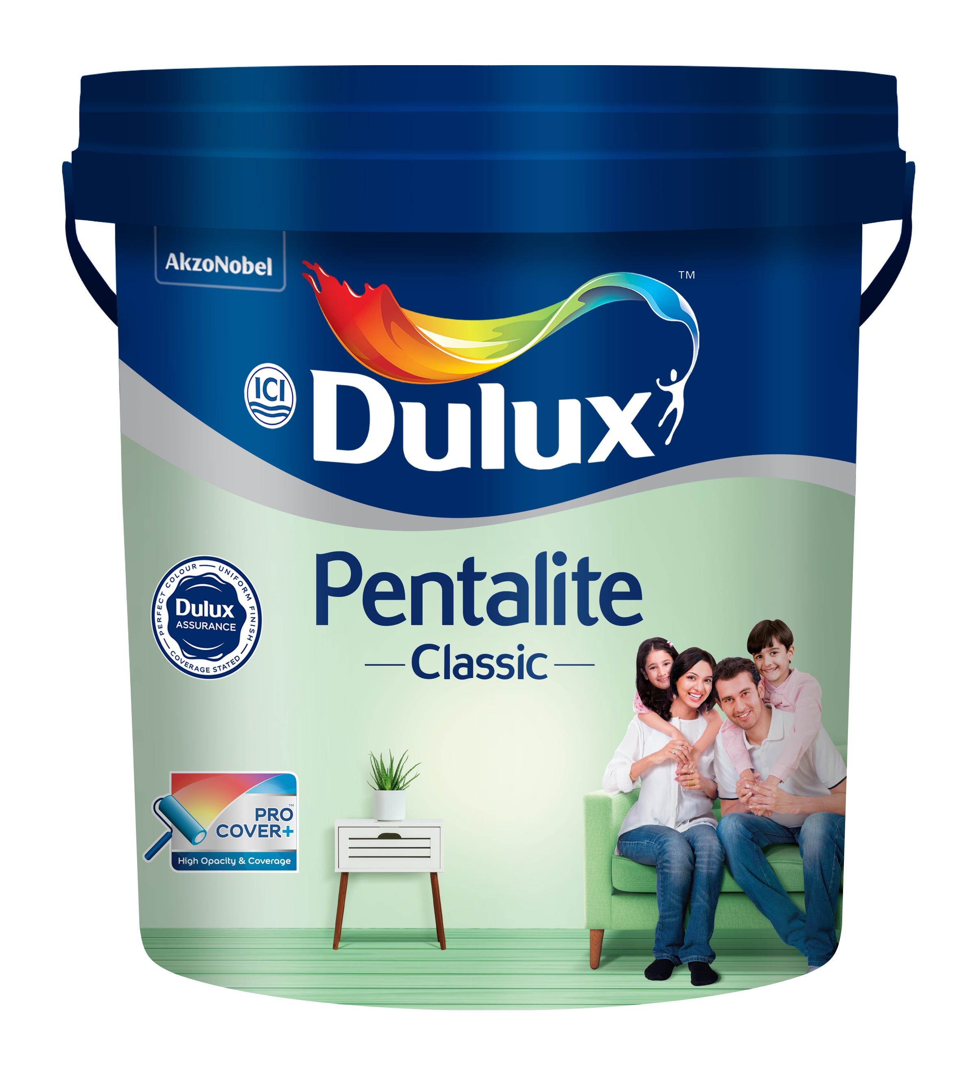
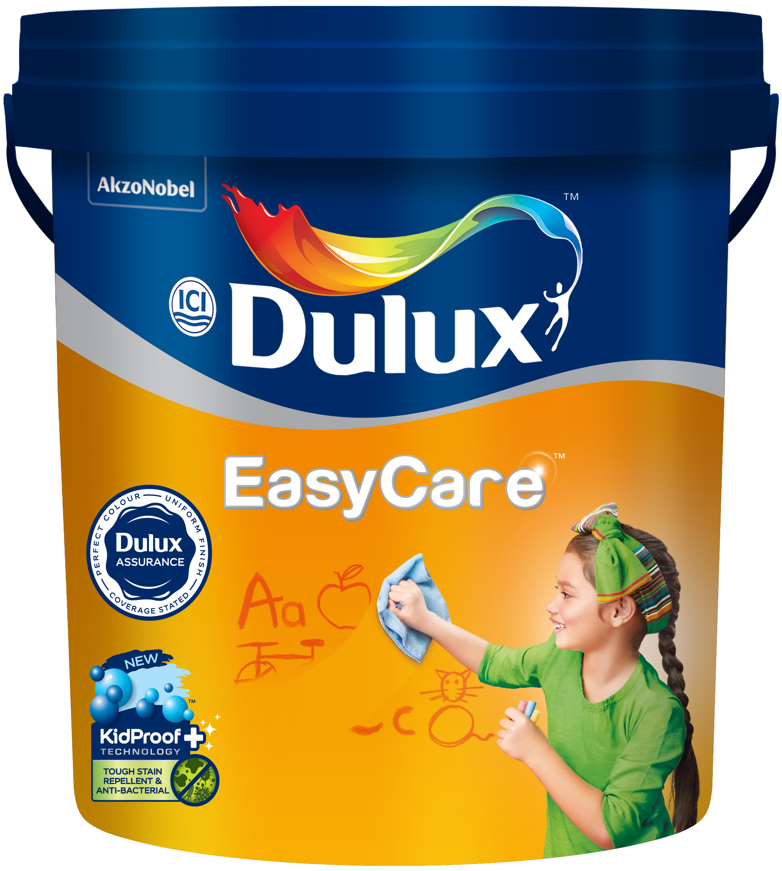
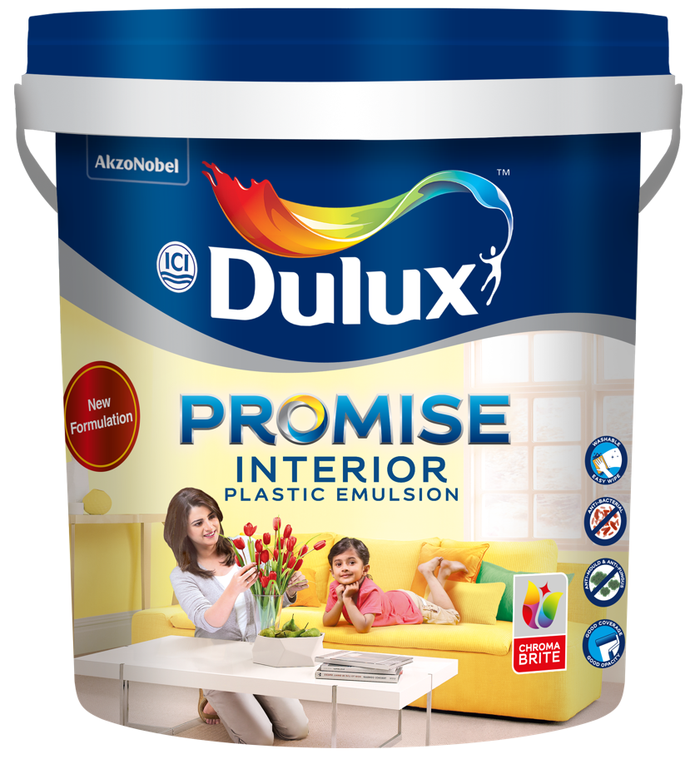
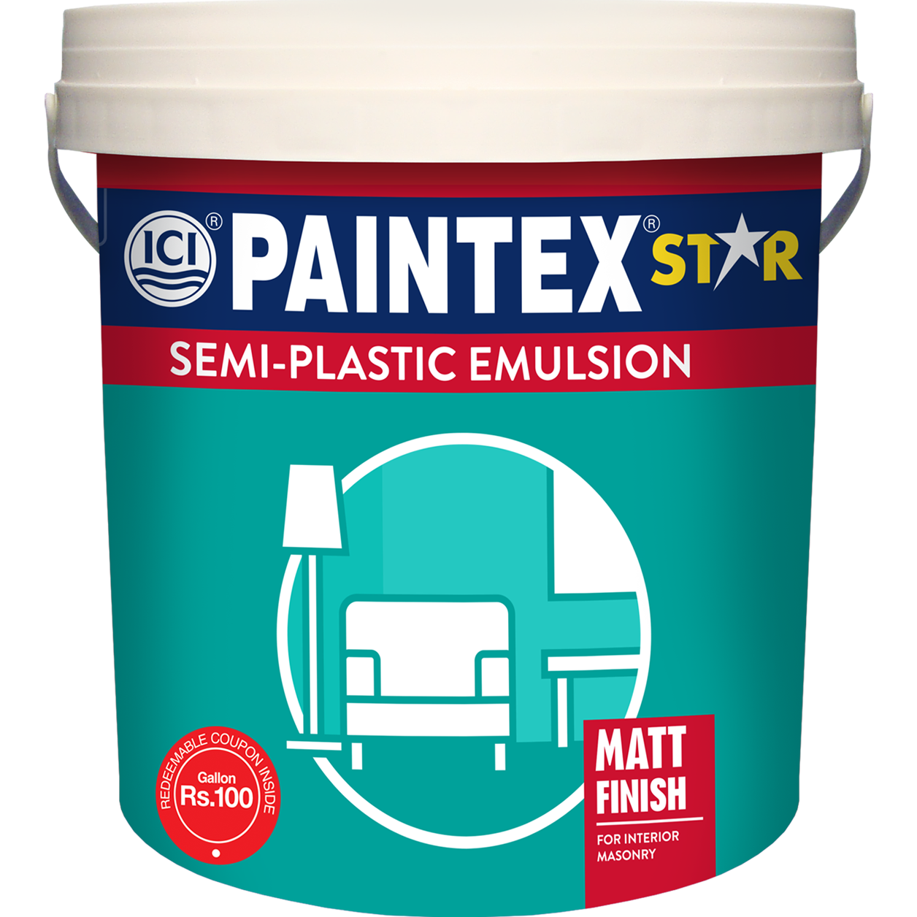
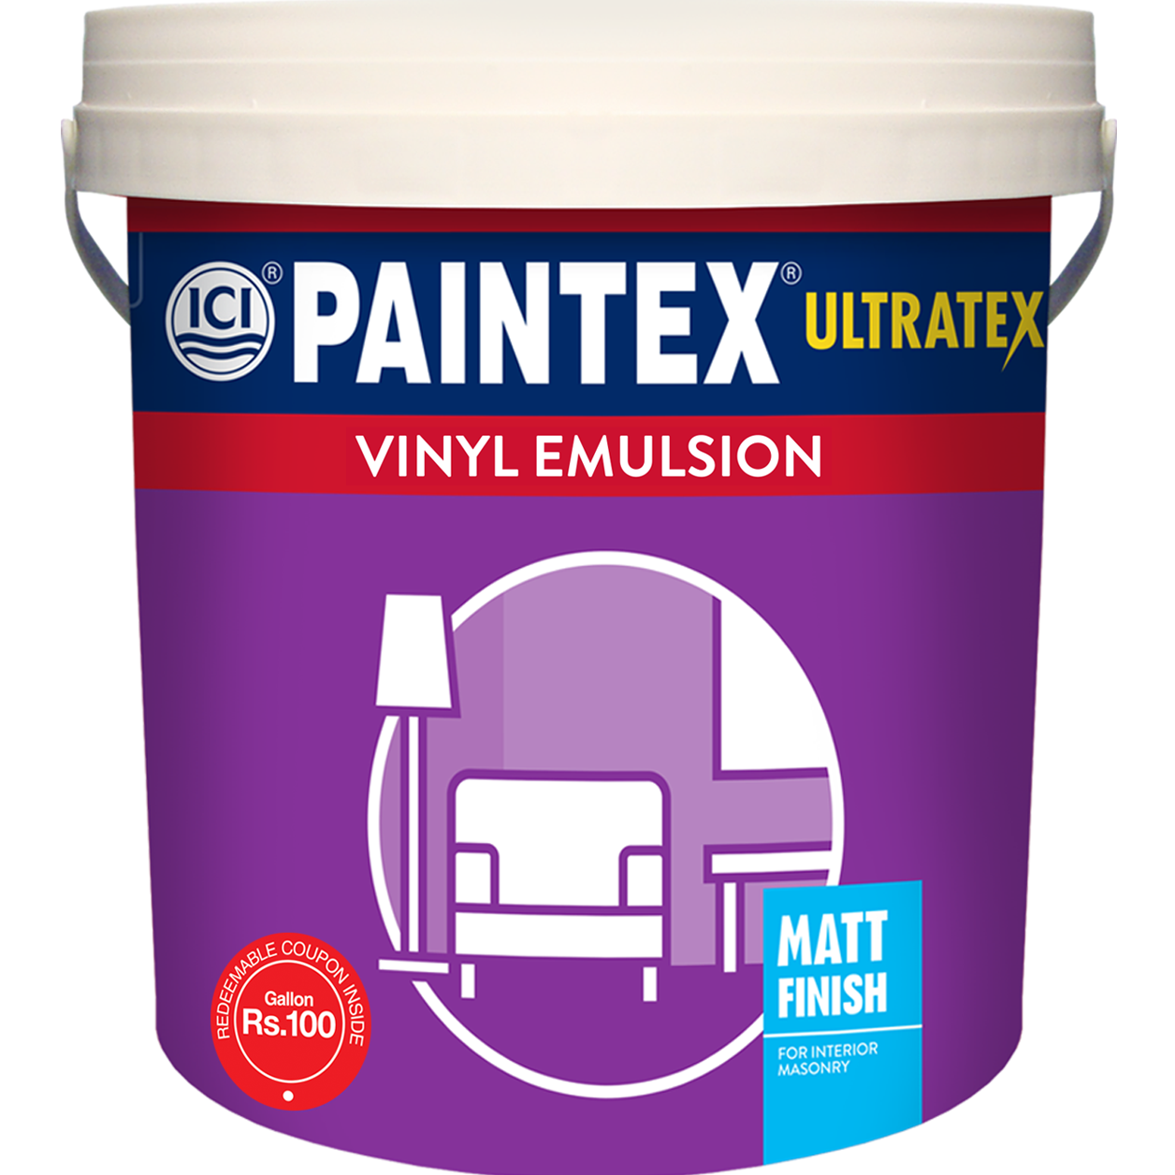
Dulux Interior Wall Paints offers a range of solutions to Farah's problems.
Notes:
Transcript:
Here's where Dulux Interior Wall Paints comes to the rescue, offering Farah a range of solutions to her problems.
Developer Notes:
Show the representative
Show images of all four products
Image Links:
https://images.akzonobel.com/akzonobel-flourish/nordsjo/sv/dulux-colour-of-the-year-2023/landing/palette/lush/Dulux-Colour-Futures-Colour-of-the-Year-2023-Lush-Colours-LivingRoom-Inspiration-Global-21.jpg?impolicy=.auto&imwidth=600
https://www.freepik.com/premium-vector/muslim-arabic-woman-character-creation-pack-with-woman-wearing-black-robe-red-hijab-arabic-woman-mouth-animation-body-parts-hand-gestures-office-items_39402565.htm#query=muslim%20charecter%20set&position=15&from_view=search&track=ais&uuid=d36b0378-2fa4-49c4-b0e1-24c379c9a2a3

Slide 8
Let's help Farah select the right kind of paint to help transform her home.
Click each type to learn more
Notes:
Transcript:
Let's help Farah select the right kind of paint to help transform her home.
Click on each type to learn more.
Developer Notes:
Show the representative
Show images of all six products
Image Links:
https://images.akzonobel.com/akzonobel-flourish/nordsjo/sv/dulux-colour-of-the-year-2023/landing/palette/lush/Dulux-Colour-Futures-Colour-of-the-Year-2023-Lush-Colours-LivingRoom-Inspiration-Global-21.jpg?impolicy=.auto&imwidth=600
https://www.freepik.com/premium-vector/muslim-arabic-woman-character-creation-pack-with-woman-wearing-black-robe-red-hijab-arabic-woman-mouth-animation-body-parts-hand-gestures-office-items_39402565.htm#query=muslim%20charecter%20set&position=15&from_view=search&track=ais&uuid=d36b0378-2fa4-49c4-b0e1-24c379c9a2a3

Slide 9
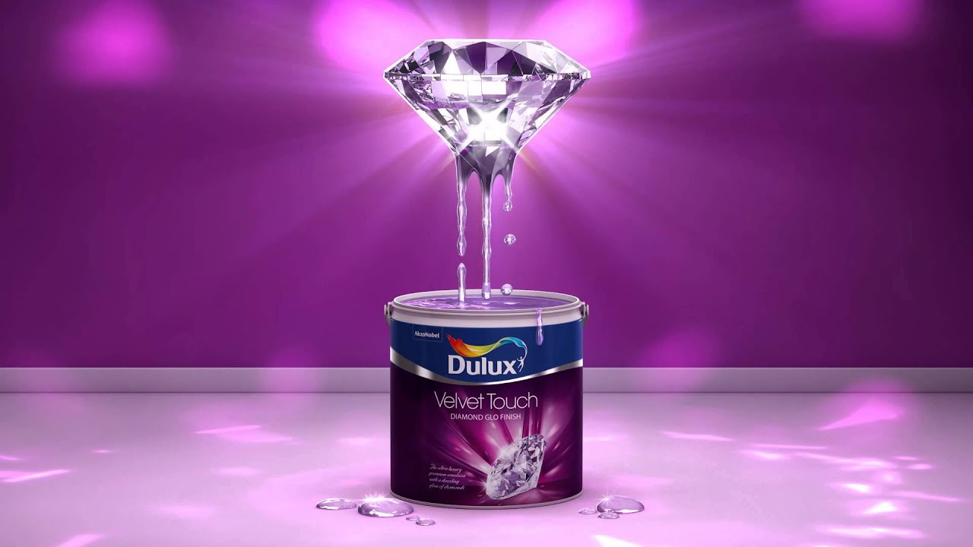


Introduction
Crafted by renowned global colour experts and designers.
Notes:
Transcript:
Dulux Ambiance introduces an exceptional painting experience, featuring cutting-edge HD Colour and Colour Guard technologies.
Our unique offering is crafted by renowned global colour experts and designers, ensuring a harmonious blend of innovation and aesthetic expertise.
Developer Notes
Show OST in sync with the VO.
Image Links:
https://www.freepik.com/free-photo/studio-background-concept-abstract-empty-light-gradient-purple-studio-room-background-product_15826661.htm#query=purple&position=18&from_view=search&track=sph&uuid=4bc23b31-aa16-4bb3-8bc4-5da2f35be7b4

Slide 10

Introduction
1
Click on the puzzle icon to hear Farah’s problem.
Notes:
Transcript:
Let's explore how Dulux Ambiance can solve Farah’s first problem.
Click on the puzzle icon to hear Farah’s problem.
Developer Notes:
Show farah tensed
Image Links:
https://www.freepik.com/free-photo/studio-background-concept-abstract-empty-light-gradient-purple-studio-room-background-product_15826661.htm#query=purple&position=18&from_view=search&track=sph&uuid=4bc23b31-aa16-4bb3-8bc4-5da2f35be7b4

Slide 11
Problem Statement
I often find myself wondering how I can shape my home to fill me with pride and joy. Can the colours and style I choose truly achieve that?
Notes:
Transcript:
I often find myself wondering how I can shape my home to fill me with pride and joy. Can the colours and style I choose truly achieve that?
Developer Notes:
Show speech bubble for farah where she is tensed looking at her wall.
Media Links:
https://www.freepik.com/free-photo/studio-background-concept-abstract-empty-light-gradient-purple-studio-room-background-product_15826661.htm#query=purple&position=18&from_view=search&track=sph&uuid=4bc23b31-aa16-4bb3-8bc4-5da2f35be7b4

Slide 12
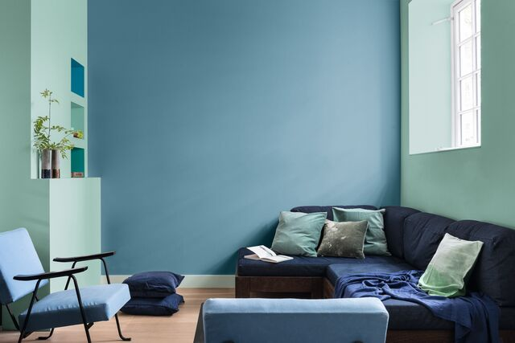
Benefits
Timeless and enduring classis colours reflect latest design
Rich and vibrant colours maintain the house beauty
Anti-fungus and anti-mould properties protect walls
Notes:
Transcript:
Addressing Farah’s concerns, Dulux Ambiance offers a range of benefits.
You can experience rich and vibrant colours that maintain the beauty of your home over time. The timeless and enduring classic colours effortlessly reflect the latest design trends. Moreover, the anti-fungus and anti-mould options protect your walls, preventing damage and preserving their integrity.
Developer Notes
Show ost syncing with Vo.
Image Link:
https://www.dulux.in/en/colour-inspiration/how-a-home-can-draw-its-power-from-colours

Slide 13
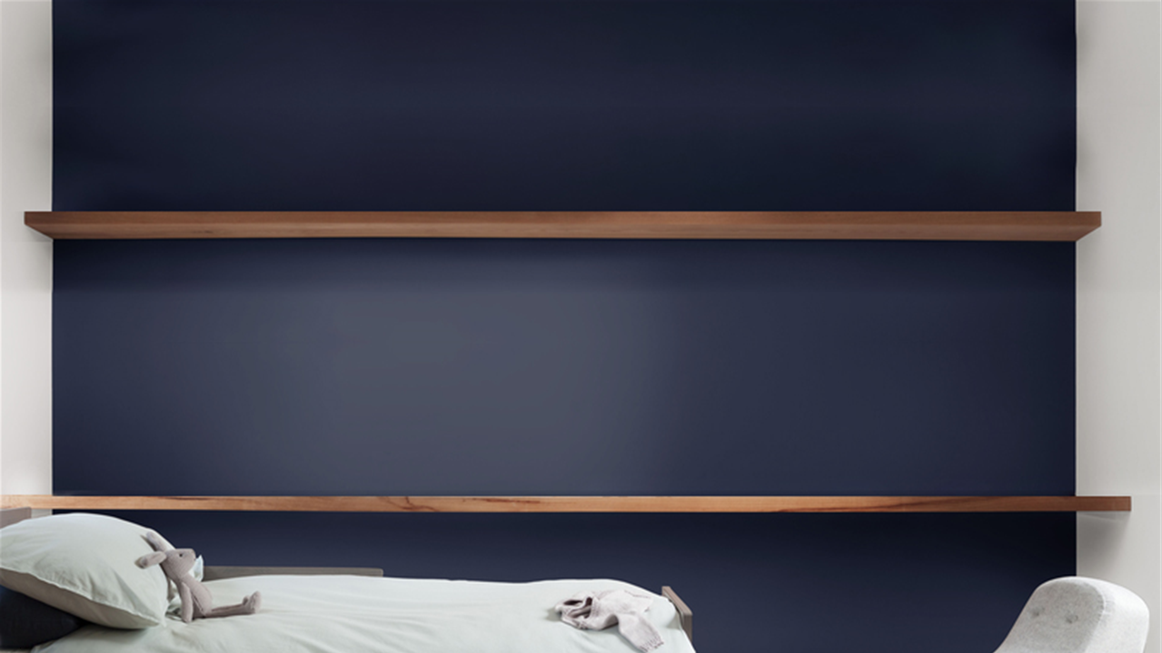
Features
Let’s now unlock some extraordinary features that set Dulux Ambiance apart.
Notes:
Transcript:
Let’s now unlock some extraordinary features that set Dulux Ambiance apart.
Developer Notes:
Show OST in sync with the VO
Image links:
https://www.dulux.in/en/colour-inspiration/team-dramatic-accents-delicate-shades

Slide 14












Features
Click on each icon to learn more.
Notes:
Transcript:
Click on each icon to learn more.
Developer Notes:
https://www.dulux.in/en/colour-inspiration/create-your-perfect-colour-scheme
https://www.flaticon.com/free-icon/padlock_3064155?term=lock&page=1&position=5&origin=search&related_id=3064155

Slide 15
Features
Smooth Finish
16-18 m²/L Coverage
High Opacity
2077 Colour Availability
Superior Washability
Best-in-Class Colour Fastness
Mould and Fungus Protection
1 L and 4 L Available Sizes
Long-Lasting Durability
Notes:
Transcript:
Experience the enduring allure of a smooth finish, ensuring your space radiates elegance and style.
Unleash the potential of every can, covering 16-18 square meters per litre with our efficient paint solution.
Embrace uncompromising quality with our high-opacity paint, concealing imperfections for a flawless, vibrant result.
Choose from a stunning array of 2077 colours, ensuring your perfect shade is just a brushstroke away.
Enjoy peace of mind with superior washability ensuring your walls stay vibrant and easy to maintain.
Experience the best-in-class colour fastness, guaranteeing that your chosen hues remain vivid and beautiful over time.
Benefit from superior mould and fungus protection, preserving your walls and ensuring a healthy living environment.
Count on long-lasting durability that stands the test of time, maintaining the beauty of your walls.
Available in two sizes, 1 L, 4 L.

Slide 16

Result
Notes:
Transcript:
As a result, Farah resolves her first issue with Dulux Ambiance, which gives her a good feeling and sense of pride through the colours and style.
Developer Notes
Show Farah looking happy. All her walls got newly painted.

Slide 17
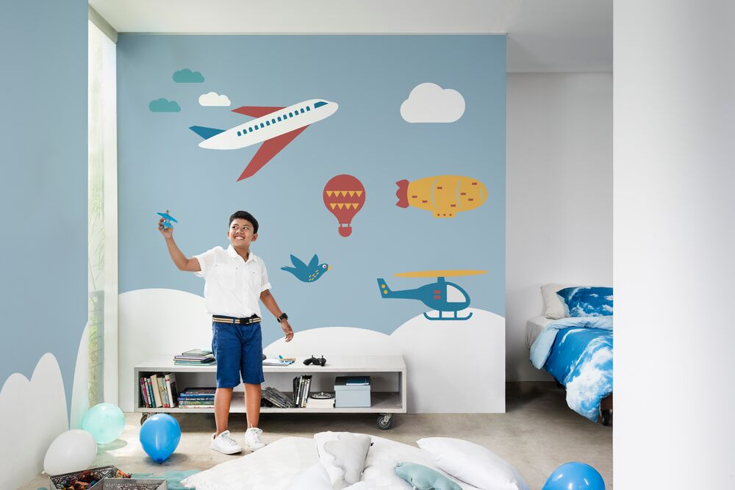

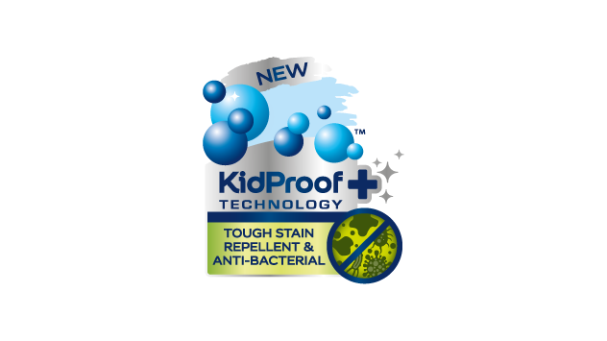
Introduction
Delays stains from penetrating on your walls.
Say goodbye to the stress of keeping your walls fresh and clean.
Notes:
Transcript:
Dulux EasyCare, featuring Kidproof+ and ColourGuard technology, effectively delays the penetration of stains, allowing for effortless cleaning, and preserving the freshness and cleanliness of your walls respectively.
Developer Notes:
Show OST in sync with the VO.
Image links:
https://www.dulux.in/en/superclean-3in1

Slide 18
Problem Statement
2
Click on the puzzle icon to hear Farah’s problem.
Notes:
Transcript:
Let's explore how Dulux EasyCare can address Farah’s second problem.
Click on the puzzle icon to hear Farah’s problem.
Developer Notes:
Show Farah tensed while looking at the walls
Image links:
https://www.flaticon.com/free-icon/puzzle_718022?term=puzzle&page=1&position=22&origin=search&related_id=718022
https://www.google.com/url?sa=i&url=https%3A%2F%2Fm.youtube.com%2Fwatch%3Fv%3DurHjqXsIKL0&psig=AOvVaw3ye8rQG3rbgEWWqq4lwJ9l&ust=1697797818531000&source=images&cd=vfe&opi=89978449&ved=0CBEQjRxqFwoTCNCV1PDzgYIDFQAAAAAdAAAAABAE

Slide 19
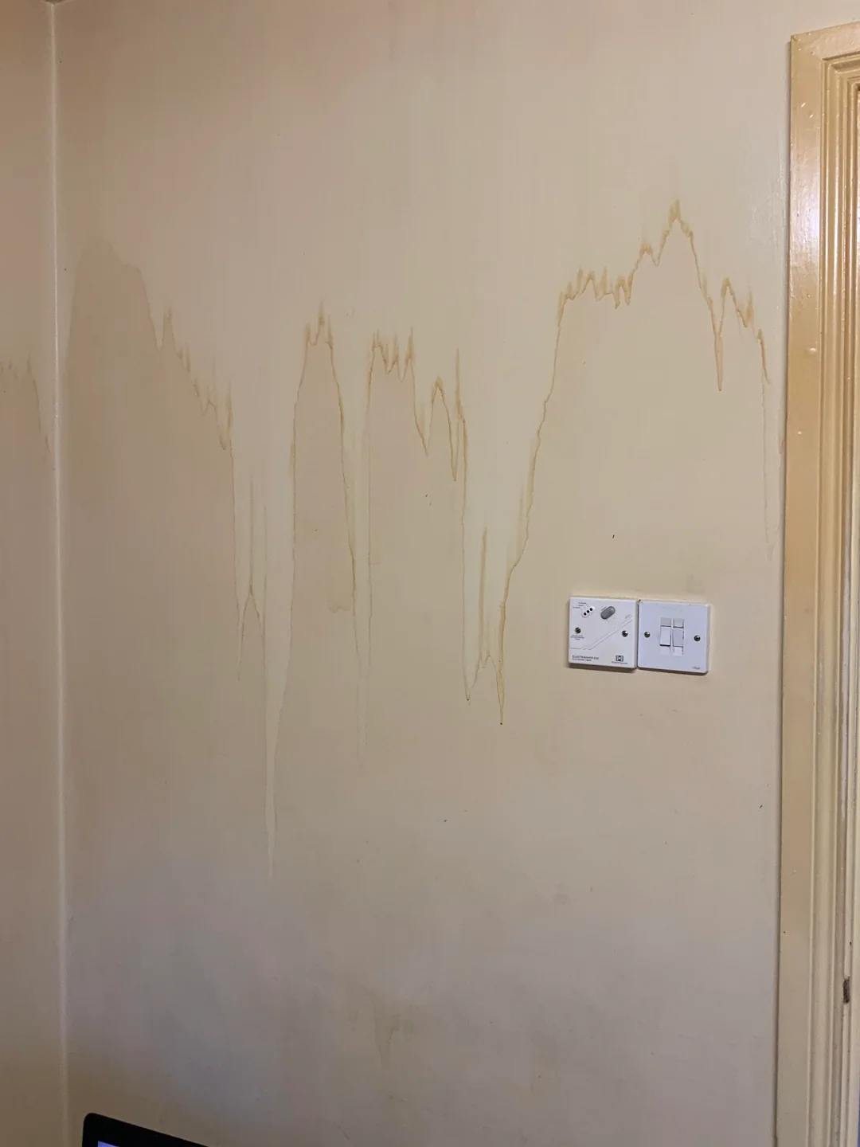
When painting a room, I want my walls to look good and stand the test of time however I know that daily life will eventually take its toll on them. How can I address this concern?
Notes:
Transcript:
When painting a room, I want my walls to look good and stand the test of time however I know that daily life will eventually take its toll on them. How can I address this concern?
Developer Notes
Show Farah tensed while looking at the walls.
Show dull walls.
Image links:
https://www.reddit.com/r/powerwashingporn/comments/hakzoj/sweating_a_years_worth_of_tobacco_stains_off_the/

Slide 20
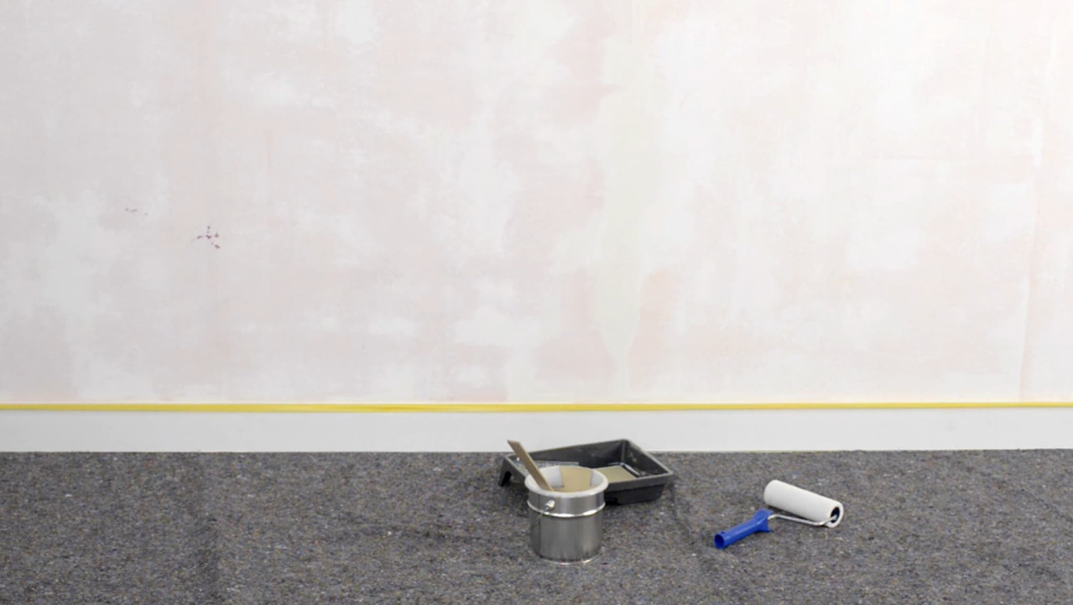
Benefits
Dulux EasyCare provides many advantages in response to Farah’s worries.
Notes:
Transcript:
Dulux EasyCare provides many advantages in response to Farah's worries.
Developer Notes
Show OST in sync with the VO
Image links:
https://www.dulux.in/en/colour-inspiration/team-dramatic-accents-delicate-shades

Slide 21




Benefits
3
2
Low Odour/ VOC
4
1
Anti-Mould and Anti-Fungus
Anti-Viral Silver Ion Technology
Germ Protection
Notes:
Transcript:
· Its Germ Protection property keeps your walls sparkling clean and fresh for a long time.
· The Anti-Mould and Anti-Fungus property safeguards your walls from unsightly mould and fungus growth.
· Its Low Odour/VOC nature ensures a pleasant painting experience with minimal fumes and environmental impact.
· The Anti-Viral Silver Ion Technology adds an extra layer of protection against harmful viruses, bolstering your wall's hygiene and safety.
Developer Notes
Show OST in sync with the VO
Image links:
https://www.dulux.in/en/colour-inspiration/team-dramatic-accents-delicate-shades
https://www.flaticon.com/free-icon/protection_2873576?term=germ+protection&page=1&position=20&origin=search&related_id=2873576
https://www.flaticon.com/free-icon/no-odor_5266847?term=odor&page=1&position=82&origin=search&related_id=5266847

Slide 22
Features
Now, let's explore the exceptional features that make the Dulux EasyCare stand out.
Notes:
Transcript:
Now, let's explore the exceptional features that make the Dulux EasyCare stand out.

Slide 23
Features
Click on each icon to learn more.
Notes:
Transcript:
Click on each icon to learn more.
·

Slide 24
Features
Smooth Finish
13-15 m²/L Coverage
High Opacity
2077 Colour Availability
Best-in-class
Washability
Superior Colour Fastness
Superior Mould and Fungus Protection
1 L, 4 L, and 16 L Available Sizes
Long-Lasting Durability
Notes:
Transcript:
Click on each icon to learn more.
· Achieve a flawlessly smooth finish with Dulux EasyCare Interior Paint.
· Benefit from extensive coverage, with 13-15 square meters per litre.
· Experience High Opacity that conceals imperfections with ease.
· Explore a palette of 2077 colours for endless design possibilities.
· Enjoy best-in-class washability for easy maintenance and upkeep.
· Witness superior colour fastness that keeps your walls vibrant.
· Ensure superior protection against mould and fungus.
· Choose from various sizes, including 1L, 4L and 16 L to suit your needs.
· Experience long-lasting durability that keeps your walls looking great for years.

Slide 25
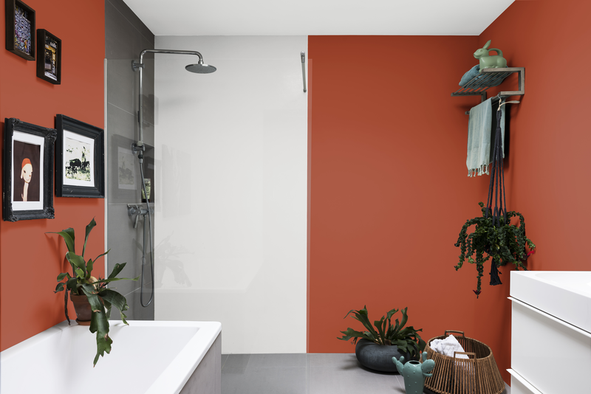
Result
Notes:
Transcript:
Consequently, Farah successfully addresses her second concern by using Dulux EasyCare, ensuring her walls maintain their appearance and durability over time.
Developer Notes:
Show Farah looking happy. All her walls looks well maintained.
Image links:
https://www.dulux.in/en/products/dulux-superclean/cccId_1561503?size=1Litre

Slide 26
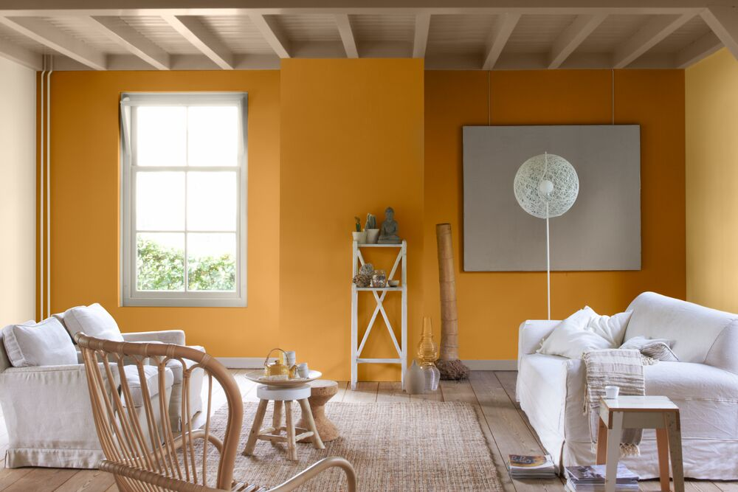


Introduction
Notes:
Transcript:
Dulux Pentalite Classic, featuring ProCover+ and ColourGuard technology, ensures your home remains both well-protected and aesthetically pleasing.
Developer Notes:
Show this paint with the text boxes, sync with VO
Image Link:
https://www.dulux.com.pk/en/colour-inspiration/eid-interior-design-ideas-for-elegance

Slide 27
Introduction
Let's delve into how Dulux Pentalite Classic can tackle Farah’s upcoming issue.
3
Notes:
Transcript:
Let's delve into how Dulux Pentalite Classic can tackle Farah’s upcoming issue.
Developer Notes:
Sync with VO
Image Link:

Slide 28
Introduction
3
Click on the puzzle icon to hear Farah’s problem.
Notes:
Transcript:
Click on the puzzle icon to hear Farah’s problem.
Developer Notes:
Image Link:

Slide 29
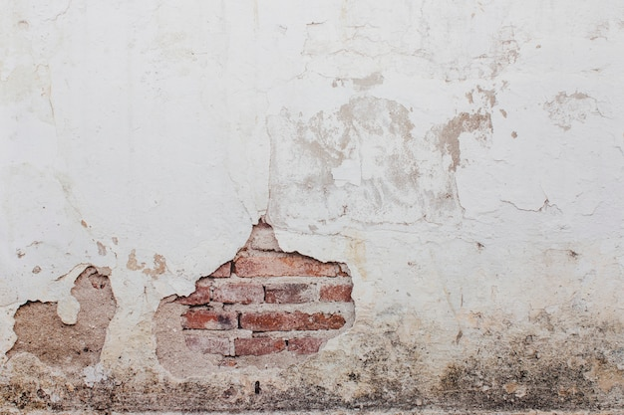
Problem Statement
My home is my pride and I want it to look the best. I want to paint with high coverage.
Notes:
Transcript:
My home is my pride and I want it to look the best. I want to paint with high coverage.
Developer Notes:
Farah looking at her wall and being sad, then show the speech bubble.
Image Link:
https://www.freepik.com/free-photo/old-wall-background_5505937.htm#query=dirty%20walls&position=11&from_view=search&track=ais&uuid=f84a4ffd-74f1-4b73-bd96-eaeba760abde

Slide 30
Benefits
Dulux Pentalite Classic offers a range of benefits to address Farah’s issue.
Notes:
Transcript:
Dulux Pentalite Classic offers a range of benefits to address Farah’s issue.
Developer Notes:
Image Link:

Slide 31


Benefits
Minimal odour and environmental impact
Wall protection
Notes:
Transcript:
Due to its low VOC content, you can experience minimal odour and environmental impact.
Additionally, its anti-mold and anti-fungus properties not only enhance the appearance of your walls but also provide protection.
Developer Notes:
Image Link:

Slide 32
Features
Dulux Pentalite Classic has distinctive features that set it apart. Let's discover what makes it unique.
Notes:
Transcript:
In addition to its numerous advantages, Dulux Pentalite Classic has distinctive features that set it apart. Let's discover what makes it unique.

Slide 33
Features
Click on each icon to learn more.
Notes:
Transcript:
Click on each icon to learn more.

Slide 34
Features
Sleek and flawless finish
14-16 m²/L Coverage
High Opacity
Good
Washability
Good Colour Fastness
Superior Mould and Fungus Protection
1 L, 4 L, and 16 L Available Sizes
Long-Lasting Durability
Notes:
Transcript:
Achieve a sleek and flawless finish with Dulux Pentalite Classic.
Experience extensive coverage with 14-16 square meters per litre, ensuring more value for your paint.
Enjoy high opacity that effectively conceals imperfections and enhances colour vibrancy.
Enjoy easy maintenance and cleaning with its good washability feature.
Witness good colour fastness, ensuring your walls retain their vibrant appearance over time.
Ensure superior protection against mould and fungus for long-lasting wall integrity.
Choose from various sizes, including 1L, 4L and 16 L to suit your needs.
Expect long-lasting durability that keeps your walls looking great for years to come.

Slide 35
Result
Enjoy stain free walls and radiant beauty with Dulux Pentalite Classic.
Notes:
Transcript:
As a result, Farah’s issue was effectively resolved by Dulux Pentalite Classic, guaranteeing walls that are free from stains and radiate beauty.
Developer notes:
Show Farah looking satisfied at her walls.
Show the walls well painted now.

Slide 36

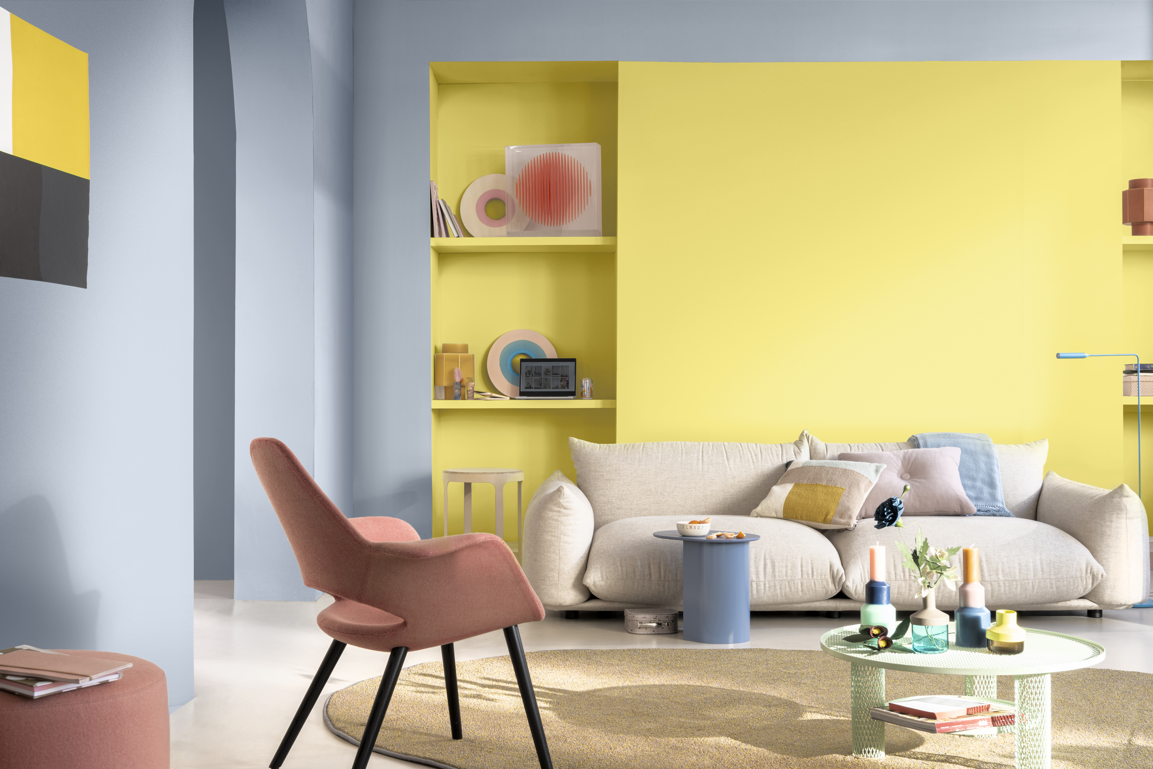
Introduction
Notes:
Transcript:
Dulux Promise Interior, for interior walls, not only has ChromaBrite technology that can keep your wall brighter for longer period.
Developer Notes:
Sync with the VO
Image links:
Provided from the raw files

Slide 37
Introduction
Let's explore how Dulux Promise Interior can address the next challenge Farah is facing.
Notes:
Transcript:
Let's explore how Dulux Promise Interior can address the next challenge Farah is facing.
Developer Notes:
Sync with the VO
Image links:
Provided from the raw files

Slide 38
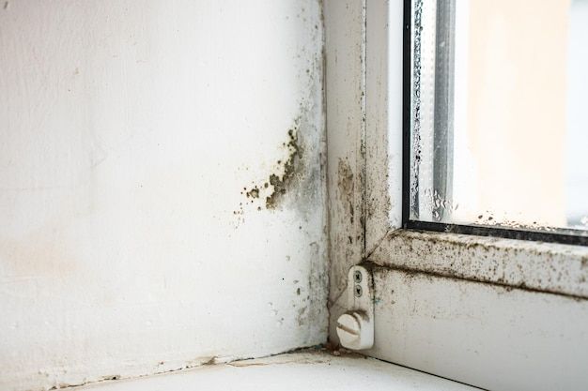
Problem Statement
4
Click on the puzzle icon to hear Farah’s problem.
Notes:
Transcript:
Click on the puzzle icon to hear Farah’s problem.
Developer Notes:
Sync with the VO
Image links:
https://www.freepik.com/premium-photo/mold-fungus-wall-white-window_35687374.htm#query=dirty%20walls%20of%20a%20house&position=25&from_view=search&track=ais&uuid=b11270e0-1205-4d64-9449-4ea9b698851f

Slide 39
Problem Statement
The walls of my home quickly accumulate dirt and lose their luster and washable paint often exceeds my budget.
Notes:
Transcript:
With the hustle and bustle in and around the house, walls can quickly accumulate dirt and lose their luster. However, washable paint often exceeds my budget.
Developer Notes:
Sync with the VO
Image links:
https://www.freepik.com/premium-photo/mold-fungus-wall-white-window_35687374.htm#query=dirty%20walls%20of%20a%20house&position=25&from_view=search&track=ais&uuid=b11270e0-1205-4d64-9449-4ea9b698851f

Slide 40
Solution
Dulux Promise Interior is the perfect choice for Farah’s concern. Let's explore the benefits it offers.
Notes:
Transcript:
Dulux Promise Interior is the perfect choice for Farah’s concern. Let's explore the benefits it offers.
Developer Notes:
Sync with the VO
Image links:
https://www.freepik.com/premium-photo/mold-fungus-wall-white-window_35687374.htm#query=dirty%20walls%20of%20a%20house&position=25&from_view=search&track=ais&uuid=b11270e0-1205-4d64-9449-4ea9b698851f

Slide 41





Benefits
Free of added Lead and Mercury
Singapore Green Label certification
Low Odour/ VOC
Anti-bacterial
Easy washable and easy-wipe
Protection against mould/ fungus
Notes:
Transcript:
Effortlessly maintain your walls' cleanliness with the convenience of washable and easy-wipe properties.
Its Low Odour/VOC nature ensures a pleasant painting experience with no harmful impact to the environment.
Our products are proudly free of added lead and mercury, prioritizing safety and environmental responsibility.
Many of our products proudly bear the Singapore Green Label, a testament to our commitment to eco-friendly and sustainable solutions.
Count on our paint's anti-bacterial properties for added cleanliness and hygiene.
Ensure superior protection against mould and fungus for long-lasting wall integrity.
Developer Notes:
Sync with the VO
Image links:
https://www.freepik.com/premium-photo/mold-fungus-wall-white-window_35687374.htm#query=dirty%20walls%20of%20a%20house&position=25&from_view=search&track=ais&uuid=b11270e0-1205-4d64-9449-4ea9b698851f

Slide 42
Features
Besides its benefits, the Dulux Promise Interior has unique characteristics that make it stand out. Let's explore these distinctive features.
Notes:
Transcript:
Besides its benefits, the Dulux Promise Interior has unique characteristics that make it stand out. Let's explore these distinctive features.

Slide 43
Features
Click on each icon to learn more.
Notes:
Transcript:
Click on each icon to learn more.

Slide 44
Features
Matt finish
13-15 m²/L Coverage
Good Opacity
2077 Colour Availability
Good
Washability
Good Colour Fastness
Long-Lasting Durability of 3-5 years
1 L, 4 L, and 16 L Available Sizes
Notes:
Transcript:
Discover the elegance of a matt finish, adding a touch of sophistication to your space.
Experience extensive coverage with 13-15 square meters per litre, maximising your paint's value.
Enjoy good opacity for enhanced colour vibrancy.
Choose from a wide spectrum of colours, with 1 ready-mix option and an impressive selection of 2077 tinting choices.
Enjoy easy maintenance with good washability.
Enjoy excellent colour protection and good colour fastness, ensuring your chosen hues stay vibrant and true.
Expect our paint to provide lasting durability, with a lifespan of 3-5 years, ensuring long-term quality and beauty.
It is available in various sizes such as 1 Litre, 4 Litres, and 16 Litres.

Slide 45
Result
Notes:
Transcript:
As a result, Farah’s issue was effectively resolved by Dulux Promise Interior.
Developer notes:
Show Farah looking satisfied looking at her walls. Show the walls well painted now.

Slide 46
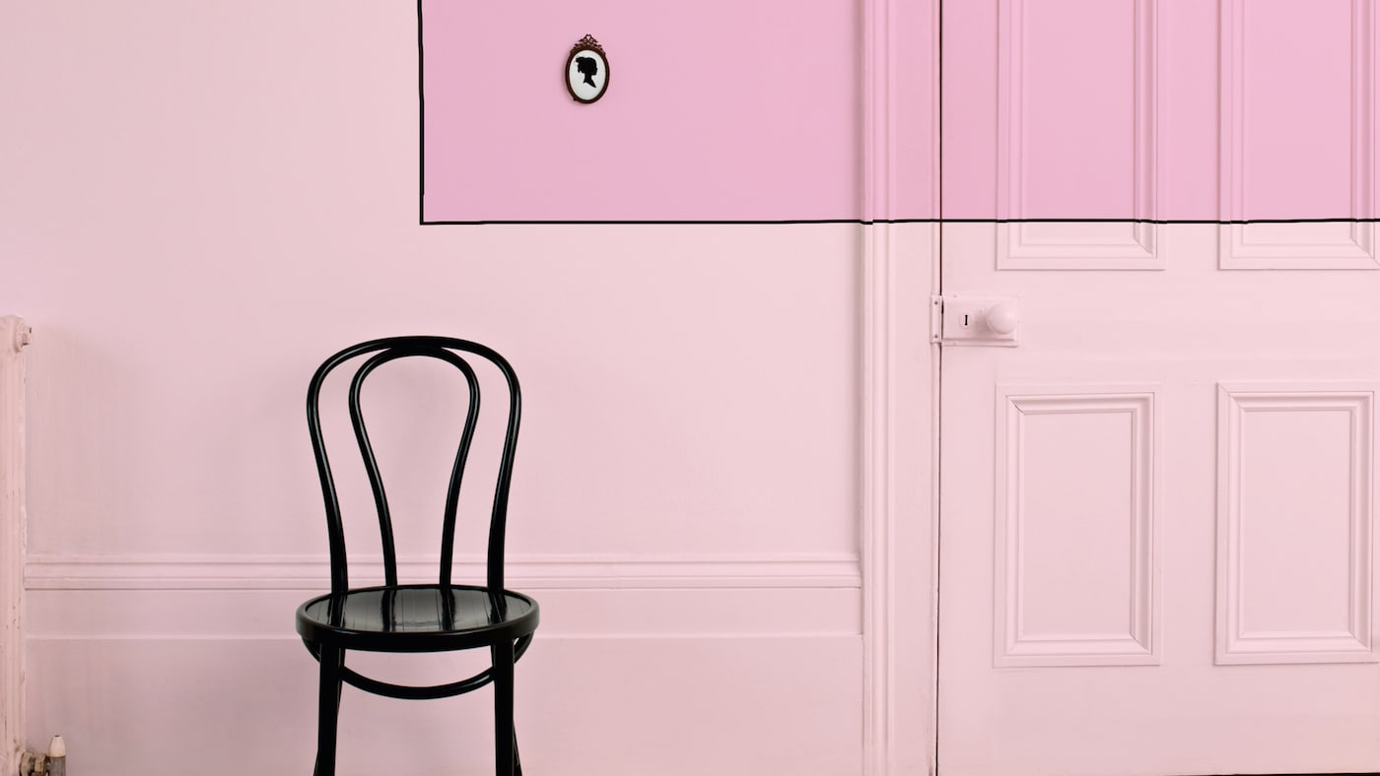
Introduction
Suitable for wall and ceiling
Offers good hiding and spreading
Notes:
Transcript:
Paintex Star is an affordable paint that simply covers the wall and ceiling. The paint comes with good hiding and spreading properties.
Developer Notes:
Sync with the VO.
Image Link:
https://www.dulux.com.pk/en/colour-inspiration/work-sophisticated-take-powder-pink
https://www.dulux.com.pk/en/products/paintex-star-semi-plastic-emulsion?size=3.64L

Slide 47
Introduction
Let's explore how Paintex Star can resolve her problem.
5
Click on the puzzle icon to hear Farah’s problem.
Notes:
Transcript:
Let's explore how Paintex Star can address the next challenge Farah is facing.
Click on the puzzle icon to hear Farah’s problem.
Develooper Notes:
Image Link:
https://www.dulux.com.pk/en/colour-inspiration/work-sophisticated-take-powder-pink

Slide 48
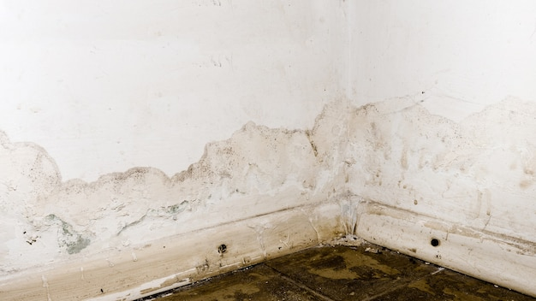
Problem Statement
My wall appears to be in poor condition, with dirt and peeling paint, leaving white marks on my shirt.
Notes:
Transcript:
My wall appears to be in poor condition, with dirt and peeling paint, leaving white marks on my shirt.
Developer Notes:
Show that Farah is gazing at her wall and looking sad. Then show the speech bubble.
Image Link:
https://www.freepik.com/premium-photo/flooding-rainwater-floor-heating-systems-causing-damage-peeling-paint-mildew-image_12539904.htm#query=dirty%20walls%20of%20a%20house&position=19&from_view=search&track=ais&uuid=616b706e-334f-4f1f-817f-bc52579deb9b

Slide 49
Problem Statement
Due to budget issues, I postponed repainting. But now I can’t delay anymore. So, what to do?
Notes:
Transcript:
While I had postponed repainting due to budget constraints and other priorities, I can't delay it any further; it's time to refresh my walls.
Developer Notes:
The speech bubble will continue here.
Image Link:
https://www.freepik.com/premium-photo/flooding-rainwater-floor-heating-systems-causing-damage-peeling-paint-mildew-image_12539904.htm#query=dirty%20walls%20of%20a%20house&position=19&from_view=search&track=ais&uuid=616b706e-334f-4f1f-817f-bc52579deb9b

Slide 50
Benefits
Paintex Star is the perfect choice for Farah’s concern. Let's explore the benefits it offers.
Notes:
Transcript:
Paintex Star is the perfect choice for Farah’s concern. Let's explore the benefits it offers.
Developer Notes:
Here the mascot will appear with the speech bubble in sync with the VO.
Image Link:
https://www.dulux.com.pk/en/colour-inspiration/work-sophisticated-take-powder-pink

Slide 51
Benefits
Resists chalking
Simple and convenient
Cost-effective
Time saving
Notes:
Transcript:
Paintex provides a cost-effective solution to meet your expectations of the wall.
This paint ensures that the wall remains resistant to chalking to maintain the durability.
It is very simple and convenient way to paint, which saves a lot of time and efforts.
Developer Notes:
Here the pop-up texts will appear around the paint in sync with VO.
Image Link:
https://www.dulux.com.pk/en/colour-inspiration/work-sophisticated-take-powder-pink

Slide 52
Features
Paintex Star has unique characteristics that make it stand out. Let’s explore its distinctive features.
Notes:
Transcript:
Besides its benefits, the Paintex Star has unique characteristics that make it stand out. Let's explore its distinctive features.
Developer Notes:
Here the mascot will appear with the speech bubble. Sync with the VO.
Image Link:

Slide 53
Features
Click on each icon to learn more.
Notes:
Transcript:
Click on each icon to learn more.
Developer Notes:
Click and reveal functionality will be there .
Image Link:

Slide 54
Features
Matt finish
12-14 m²/L Coverage
Basic Opacity
15 ready mixed colours
Basic Colour Protection
Long-Lasting Durability of 1-2 years
3.6 L and 14.56 L Available Sizes
Notes:
Transcript:
Experience the sophistication of a matt finish, elevating the elegance of your surroundings.
Experience extensive coverage with 12-14 square meters per litre, maximising your paint's value.
Enjoy basic opacity for enhanced colour vibrancy.
Select from a versatile palette with 15 ready mixed colour options.
Offers basic colour protection for your walls.
Provides lasting durability, with a lifespan of 1-2 years, ensuring long-term quality and beauty.
Available in two different sizes such as 3.6 L and 14.56 L.
Developer Notes:
Image Link:

Slide 55
Result
Enjoy stain free walls and radiant beauty with Paintex Star.
Notes:
Transcript:
As a result, Farah’s issue was effectively resolved by Paintex Star, guaranteeing walls that are free from stains and radiate beauty.
Developer Notes:
Show Farah looking satisfied looking at her walls. Show the walls well painted now.
Image Link:

Slide 56
Introduction
Affordable for your wall and ceiling.
Notes:
Transcript:
Paintex Ultratex is a very affordable paint that simply covers the wall and ceiling.
Developer Notes:
Show OST in sync with the VO.
Image Link:
Taken from the raw file

Slide 57
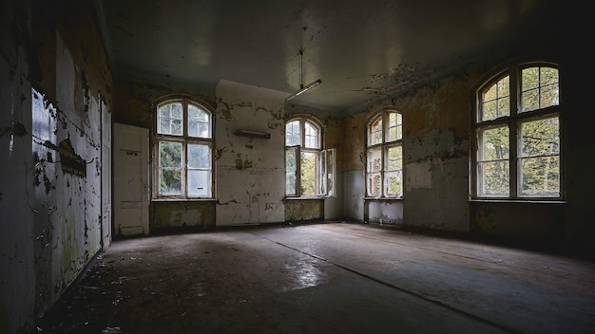
Introduction
Let's explore how Paintex Ultratex can address the next challenge Farah is facing.
6
Click on the puzzle icon to hear Farah’s problem.
Notes:
Transcript:
Let's explore how Paintex Ultratex can address the next challenge Farah is facing.
Click on the puzzle icon to hear Farah’s problem.
Developer Notes:
Show OST in sync with the VO.
Image Link:
https://www.freepik.com/free-photo/beautiful-view-interior-old-abandoned-building_13292407.htm#query=dirty%20ceiling%20of%20a%20house&position=24&from_view=search&track=ais&uuid=abc8d6ea-1088-4cb1-98d9-0723b38e7052

Slide 58
Problem Statement
My wall looks shabby. It is very dirty, peeling off here and there.
Notes:
Transcript:
My wall looks shabby. It is very dirty, peeling off here and there.
Developer Notes:
Show OST in sync with the VO.
Image Link:
https://www.freepik.com/free-photo/beautiful-view-interior-old-abandoned-building_13292407.htm#query=dirty%20ceiling%20of%20a%20house&position=24&from_view=search&track=ais&uuid=abc8d6ea-1088-4cb1-98d9-0723b38e7052

Slide 59
Problem Statement
Due to budget issues, I postponed repainting this too earlier. Now I must repaint it soon, therefore I need an affordable paint.
Notes:
Transcript:
I was supposed to repaint it months ago, but my money is very limited and home decoration is not on my priority list. I was extremely economical paint for my home.
Developer Notes:
Show OST in sync with the VO.
Image Link:
https://www.freepik.com/free-photo/beautiful-view-interior-old-abandoned-building_13292407.htm#query=dirty%20ceiling%20of%20a%20house&position=24&from_view=search&track=ais&uuid=abc8d6ea-1088-4cb1-98d9-0723b38e7052

Slide 60
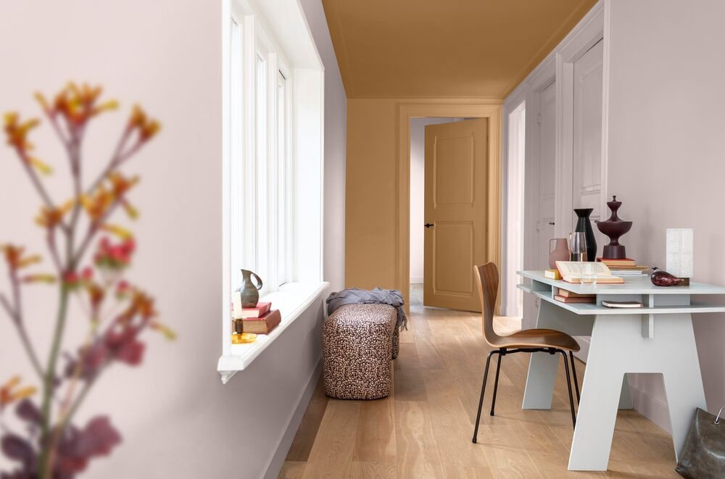
Solution
Paintex Ultratex is the perfect choice for Farah’s concern. Let's explore the benefits it offers.
Notes:
Transcript:
Paintex Ultratex is the perfect choice for Farah’s concern. Let's explore the benefits it offers.
Developer Notes:
Show OST in sync with the VO.
Image Link:
https://www.dulux.com.pk/en/colour-inspiration/trendiest-paint-colours-for-home-decor

Slide 61
Benefits
Simple and convenient
Chalk resistive
Cost-effective
Notes:
Transcript:
Paintex offers a budget friendly solution to meet the expectations of the wall.
This paint guarantees resistance to chalking and ensures durability.
Provides simple and convenient painting solution.
Developer Notes:
Show OST in sync with the VO.
Image Link:

Slide 62
Features
Paintex Ultratex has unique characteristics that make it stand out. Let's explore these distinctive features.
Notes:
Transcript:
Besides its benefits, the Paintex Ultratex has unique characteristics that make it stand out. Let's explore these distinctive features.
Developer Notes:
Show OST in sync with the VO.
Image Link:
Taken from the raw file

Slide 63
Features
Click on each icon to learn more.
Notes:
Transcript:
Click on each icon to learn more.
Developer Notes:
Click and reveal functionality will be there .
Image Link:
Taken from the raw file

Slide 64
Features
Matt finish
10 – 12 m²/L Coverage
Basic Opacity
3 ready mixed colours
Basic Colour Protection and Colour Fastness
Long-Lasting Durability of 1-2 years
6 kg and 24 Kg Available Sizes
Notes:
Transcript:
Experience the sophistication of a matt finish, elevating the elegance of your surroundings.
Offers extensive coverage with 10-12 square meters per litre, maximising your paint's value.
Provides basic opacity for enhanced colour vibrancy.
Select from a versatile palette with 3 ready-mix colour options.
Provides basic colour protection and colour fastness.
Expect our paint to provide lasting durability, with a lifespan of 1-2 years, ensuring long-term quality and beauty .
Available in various sizes such as 6 Kg and 24 Kg to suit your need.
Developer Notes:
Show OST in sync with the VO.
Image Link:
Taken from the raw file

Slide 65
Result
Enjoy stain free walls and radiant beauty with Paintex Ultratex.
Notes:
Transcript:
As a result, Farah’s issue was effectively resolved by Paintex Ultratex, guaranteeing walls that are free from stains and radiate beauty.
Developer Notes:
Show Farah looking satisfied looking at her walls. Show the walls well painted now.
Image Link:
Taken from the raw file

Slide 66
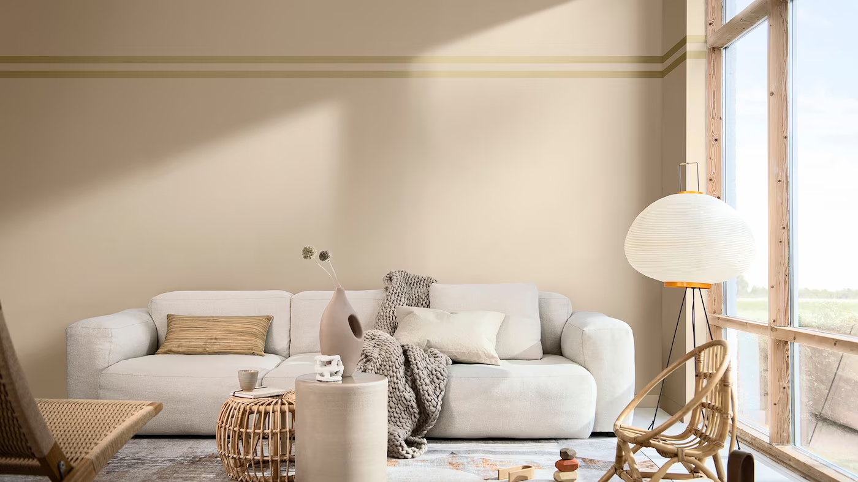
Conclusion
Dulux Interior Wall Paints gave Farah the house she desired for.
Notes:
Transcript:
Farah successfully resolved all her house issues with the assistance of Dulux Interior Wall Paints, restoring the beauty of her walls once more.
Developer Notes:
Show farah looking happy. All her walls look beautiful now.
Image Link:
Taken from the raw file

Slide 67
Thank You

